Slide 1

Forecasting COVID-19 cases using SARS-Cov2 Titers in Urban Wastewater
CS-109B: Group #111
Spring 2021
TEAM
Vivek Bhatia
Prakash Bhatt
Lalitanjali Bondili
Raghu Soori

Slide 2
CONTENTS
Background
Datasets
Exploratory Data Analysis
Models Selection
Model Evaluation
Conclusion & Next Steps
Final Project Group #111 V Bhatia, P Bhatt, L Bondili, R Soori
2

Slide 3
Background
Since the start of the SARS-CoV-2 (COVID-19) pandemic, an accurate count of cases in the community is tracked by symptomatically and clinically diagnosed cases.
This method has inherent drawback as many of the patients do not report the disease and/or maybe asymptomatic [1].
Studies have shown proof of gastro-intestinal disorders triggered by SARS-CoV-2 infections in patients and the occurrence of viral RNA in community wastewater plants [2].
Wastewater-based epidemiological surveillance can be used as an early warning system for disease outbreak and to forecast the rate of transmission in communities.
We intend to explore the relationship between SARS-CoV-2 titers in urban wastewater and the rate of infections in nearby communities and design models to forecast the rate of infections using titer information as proxy data (a.k.a Nowcasting).
[1] Wu et al. SARS-CoV-2 titers in wastewater foreshadow dynamics and clinical presentation of new COVID-19 cases (202)
[2] Xiao et al. Evidence for gastrointestinal infection of SARS-CoV-2 (2020)
Final Project Group #111 V Bhatia, P Bhatt, L Bondili, R Soori
3

Slide 4
DATASETS

Slide 5
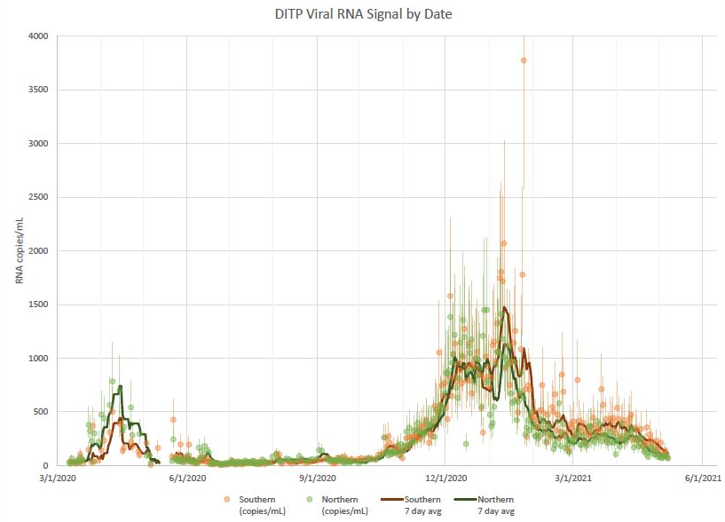
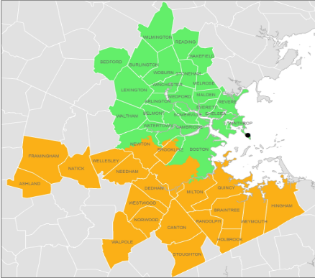
Dataset
MWRA Wastewater COVID-19 Tracking Data - Collected by Massachusetts Water Resources Authority measuring the quantity of SARS-CoV-2 viral RNA samples in sewage wastewater for Boston’s Southern and Northern districts
Figure: Northern (Green) and Southern (Orange) Boston Districts
Figure: Viral RNA collection data over time in Boston Counties
Source: https://www.mwra.com/biobot/biobotdata.htm
Final Project Group #111 V Bhatia, P Bhatt, L Bondili, R Soori
5

Slide 6
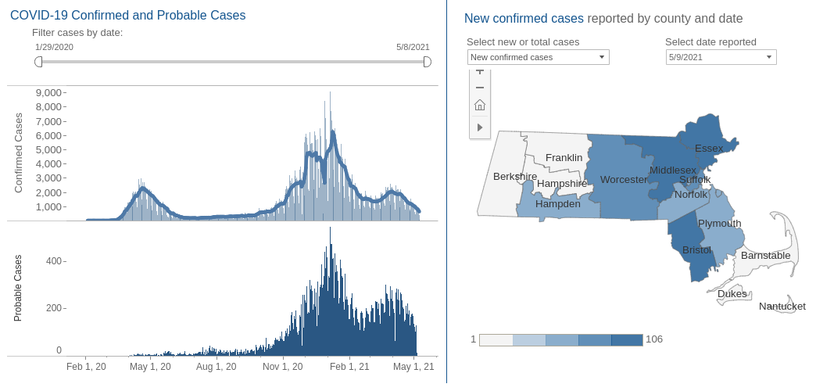
Dataset
Massachusetts official COVID-19 Case Count: Publicly available dataset provided by the Massachusetts Department of Public Health
Source: https://www.mass.gov/info-details/covid-19-response-reporting#covid-19-interactive-data-dashboard-
Final Project Group #111 V Bhatia, P Bhatt, L Bondili, R Soori
6

Slide 7
EXPLORATORY DATA ANALYSIS

Slide 8
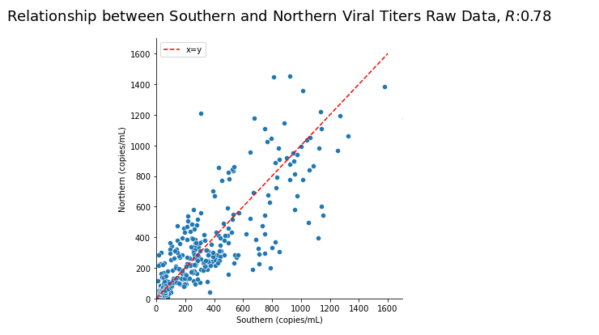
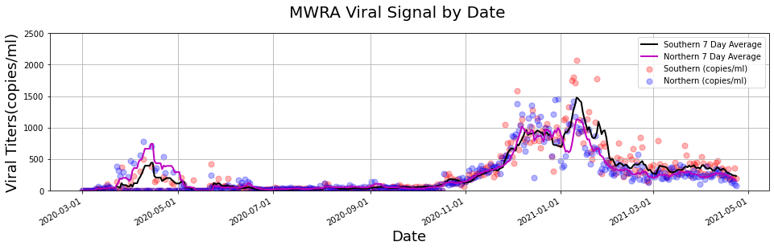
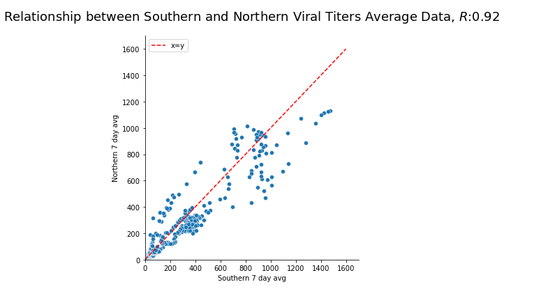
Exploratory Data Analysis – MWRA
TAKE AWAYS
Raw daily values are noisy and show a lot of variability, the 7 day rolling average is much smoother and should work well as the input predictors
Strong linear relationship between Southern and Northern titer 7 day average values
Final Project Group #111 V Bhatia, P Bhatt, L Bondili, R Soori
8

Slide 9
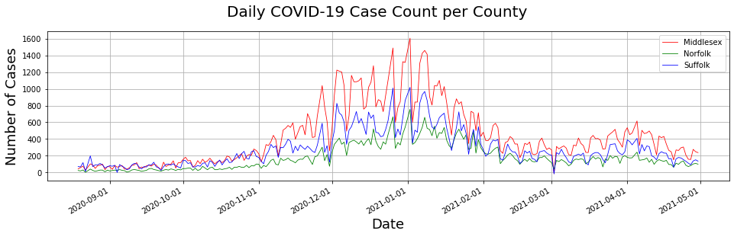
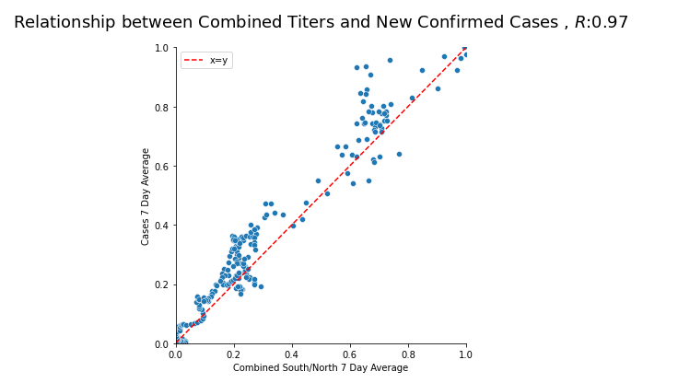
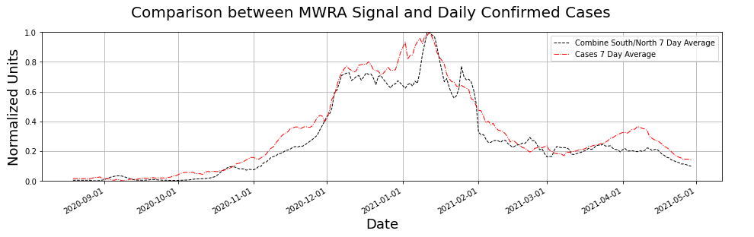
Exploratory Data Analysis – MASS COVID-19 Data
TAKE AWAY
Daily case count for Massachusetts is also noisy and shows seasonal variations with a window of 7-10 days.
7 Day rolling Average of confirmed cases count shows strong linear relationship with both Southern and Northern Titer Average Values.
Final Project Group #111 V Bhatia, P Bhatt, L Bondili, R Soori
9

Slide 10
Dataset Preprocessing
MWRA Wastewater Dataset:
Missing values in the dataset were imputed using ‘ARIMA’ forecasts.
Since raw values were noisy, we computed a 7 day rolling average for use as predictor variables.
MASS COVID-19 Case Count:
Daily case count is available for Massachusetts on a per county level, however, since our waste water RNA signal is combined into Southern and Northern Boston districts, we combine the three counties of Middlesex, Norfolk and Suffolk to get a combined case count for Greater Boston Area.
Since raw values were noisy, we computed a 7 day rolling average for use the response variable.
Missing values in the dataset were imputed using ‘ARIMA’ forecasts.
Alignment:
Time Range for the datasets were aligned to only consider the intersection of dates where both MWRA Signal and Daily Case Counts were available (08/2020 – 05/2021)
Normalization:
Dataset was normalized to values between [0,1] to allow for standardized comparison scale for neural networks and linear regression models alike.
Train/Test Split:
Train – 70 % , Test – 30 %
Final Project Group #111 V Bhatia, P Bhatt, L Bondili, R Soori
10
Notes:
Now coming to data processing,
Our target variable has different interpretations for positive and negative values.
so we used an absolute value where lower number would indicate high mortality risk and higher number would indicate lower risk.
For identifying race, we used the distribution of race in 70s and for sex, we leveraged the fact that males and females have different ranges for some of the clinical variables like RBC.
For filling in the missing data in our dataset, we used an iterative imputer.
We added some new flags indicating predictors outside of normal range. e.g. if a person had high BMI, we would either flag it as 1 or 2 depending on the range and then used a sum_flag that would add up these flags to indicate an overall health of a person.
10

Slide 11
MODEL SELECTION
Final Project Group #111 V Bhatia, P Bhatt, L Bondili, R Soori
11
Notes:
Now coming to data processing,
Our target variable has different interpretations for positive and negative values.
so we used an absolute value where lower number would indicate high mortality risk and higher number would indicate lower risk.
For identifying race, we used the distribution of race in 70s and for sex, we leveraged the fact that males and females have different ranges for some of the clinical variables like RBC.
For filling in the missing data in our dataset, we used an iterative imputer.
We added some new flags indicating predictors outside of normal range. e.g. if a person had high BMI, we would either flag it as 1 or 2 depending on the range and then used a sum_flag that would add up these flags to indicate an overall health of a person.
11

Slide 12
Model Selection
Given the strong linear relationship between the titer average values and the confirmed daily case count average values, we suspect linear regression models might work best for this problem. We explore the use of the following models for forecasting daily case count:
Naive Model
We develop a baseline persistence model for evaluating performance of other models. This model uses the case count values from previous day (t-1) to predict the values for the current day (t).
Linear and Polynomial Regression
We evaluate the use of simple linear and regression models solved using Ordinary Least-Squares.
Generalized Linear Models
We suspect piece-wise linear models like GAMs might tend to work better than simple linear models, we develop such a model using Penalized B-Splines.
Gradient Boosting Classifiers
Recurrent Neural Networks
Since our time series data is sequential, we explore the use of recurrent neural networks such as Gated Recurrent Units, LSTM with and without BiDirectional Layers to create deep neural networks.
Final Project Group #111 V Bhatia, P Bhatt, L Bondili, R Soori
12
Notes:
Now coming to data processing,
Our target variable has different interpretations for positive and negative values.
so we used an absolute value where lower number would indicate high mortality risk and higher number would indicate lower risk.
For identifying race, we used the distribution of race in 70s and for sex, we leveraged the fact that males and females have different ranges for some of the clinical variables like RBC.
For filling in the missing data in our dataset, we used an iterative imputer.
We added some new flags indicating predictors outside of normal range. e.g. if a person had high BMI, we would either flag it as 1 or 2 depending on the range and then used a sum_flag that would add up these flags to indicate an overall health of a person.
12

Slide 13
MODEL EVALUATION
Final Project Group #111 V Bhatia, P Bhatt, L Bondili, R Soori
13
Notes:
Now coming to data processing,
Our target variable has different interpretations for positive and negative values.
so we used an absolute value where lower number would indicate high mortality risk and higher number would indicate lower risk.
For identifying race, we used the distribution of race in 70s and for sex, we leveraged the fact that males and females have different ranges for some of the clinical variables like RBC.
For filling in the missing data in our dataset, we used an iterative imputer.
We added some new flags indicating predictors outside of normal range. e.g. if a person had high BMI, we would either flag it as 1 or 2 depending on the range and then used a sum_flag that would add up these flags to indicate an overall health of a person.
13

Slide 14
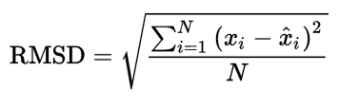
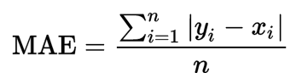
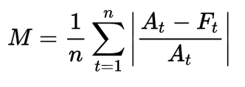
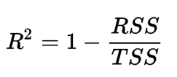
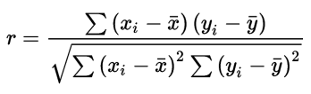
Evaluation Metrics
For model evaluation, we use common metrics for time series comparison in similar forecasting problems for evaluating the performance of our models relative to the naive model.[1]
Root Mean Square Error (RMSE) ->
Mean Absolute Error (MAE) ->
Mean Absolution Percentage Error (MAPE) -->
R^2 Score ->
Pearson’s Correlation Coefficient (R-Value) ->
[1] Yang et al. Accurate estimation of influenza epidemics using ARGO (2015)
Final Project Group #111 V Bhatia, P Bhatt, L Bondili, R Soori
14
Notes:
Now coming to data processing,
Our target variable has different interpretations for positive and negative values.
so we used an absolute value where lower number would indicate high mortality risk and higher number would indicate lower risk.
For identifying race, we used the distribution of race in 70s and for sex, we leveraged the fact that males and females have different ranges for some of the clinical variables like RBC.
For filling in the missing data in our dataset, we used an iterative imputer.
We added some new flags indicating predictors outside of normal range. e.g. if a person had high BMI, we would either flag it as 1 or 2 depending on the range and then used a sum_flag that would add up these flags to indicate an overall health of a person.
14

Slide 15
ATTEMPT # 1
USING STANDARD PREDICTORS
Final Project Group #111 V Bhatia, P Bhatt, L Bondili, R Soori
15
Notes:
Now coming to data processing,
Our target variable has different interpretations for positive and negative values.
so we used an absolute value where lower number would indicate high mortality risk and higher number would indicate lower risk.
For identifying race, we used the distribution of race in 70s and for sex, we leveraged the fact that males and females have different ranges for some of the clinical variables like RBC.
For filling in the missing data in our dataset, we used an iterative imputer.
We added some new flags indicating predictors outside of normal range. e.g. if a person had high BMI, we would either flag it as 1 or 2 depending on the range and then used a sum_flag that would add up these flags to indicate an overall health of a person.
15

Slide 16
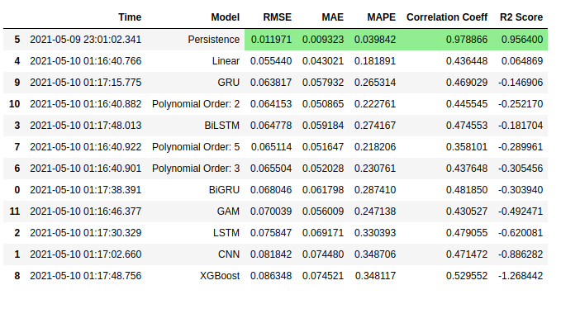
Model Comparison
Predictor Variables:
7 Day Rolling Average of Southern Viral RNA Signal
7 Day Rolling Average of Northern Viral RNA Signal
Response Variables:
7 Day Rolling Average of Confirmed COVID-19 Case Count
Figure: Evaluation of performance metrics relative to the baseline (Persistence) Model using Test Data
Final Project Group #111 V Bhatia, P Bhatt, L Bondili, R Soori
16

Slide 17
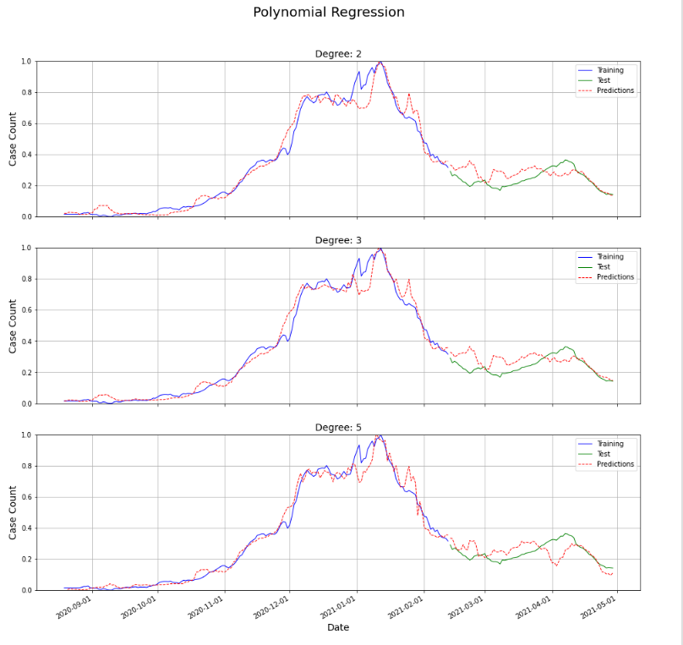
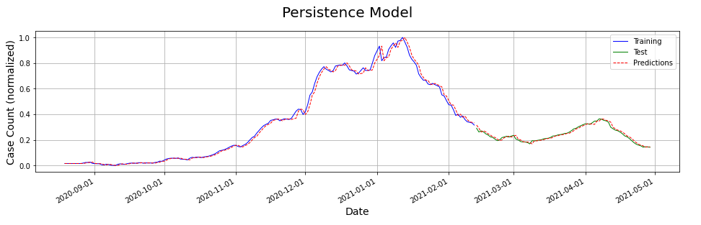
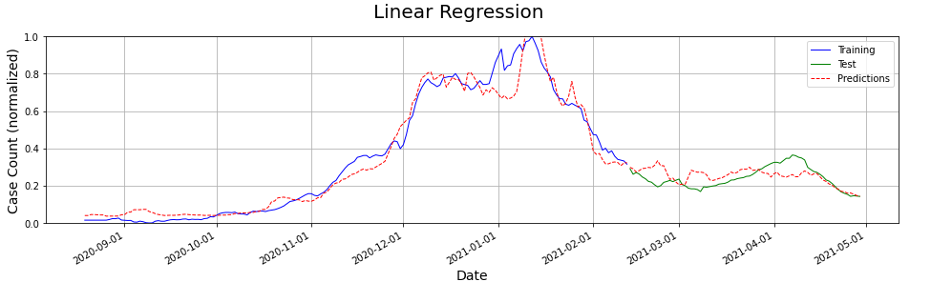
Model Predictions – Baseline Model and Simple Regression
Final Project Group #111 V Bhatia, P Bhatt, L Bondili, R Soori
17
Notes:
As Vivek explained, this is the persistence model, the output of which we used as a predictor variable for the other models.
It helps us take into account the number of covid cases in the most recent past to predict the number of covid cases in the near future.
First, we tried linear regression and polynomial regression with degrees 2,3,5 and 8. Linear Regression performed better when compared to the polynomial models.
We can also clearly see that increasing the degree increases the variance in the predicted values.

Slide 18
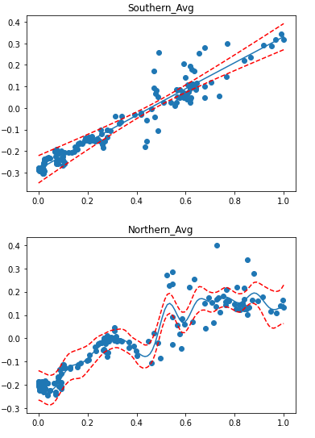
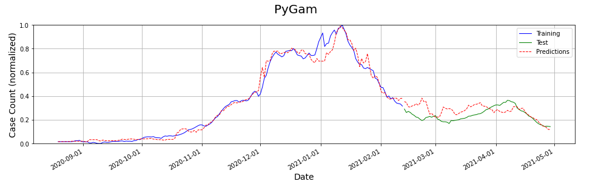
Model Predictions – Generalized Linear Models
Final Project Group #111 V Bhatia, P Bhatt, L Bondili, R Soori
18
Notes:
First, we tried linear regression and polynomial regression with degrees 2,3,5 and 8. Linear Regression performed better when compared to the polynomial models.
We can also clearly see that increasing the degree increases the variance in the predicted values.

Slide 19
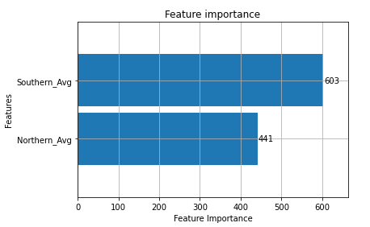
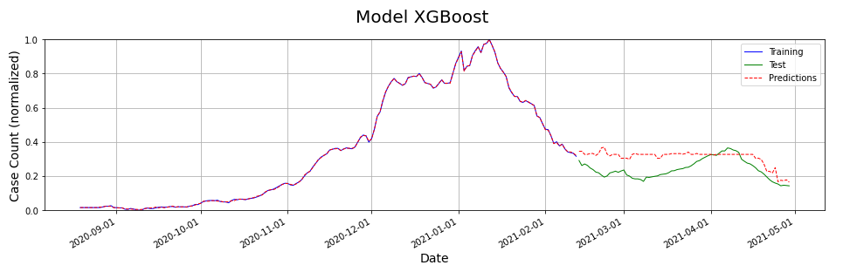
Model Predictions – Gradient Boosting Regression Model
Final Project Group #111 V Bhatia, P Bhatt, L Bondili, R Soori
19
Notes:
We also tried the XGBoost Model which is a decision tree based ensemble model. The feature importance plot shows that Southern_Avg is the most important feature.

Slide 20
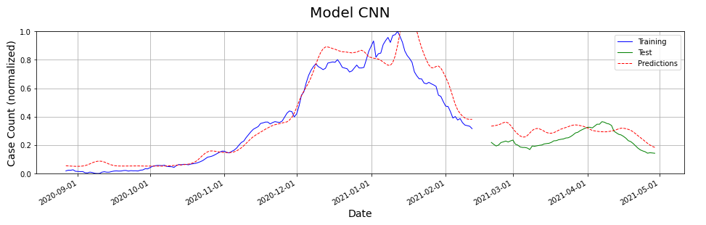
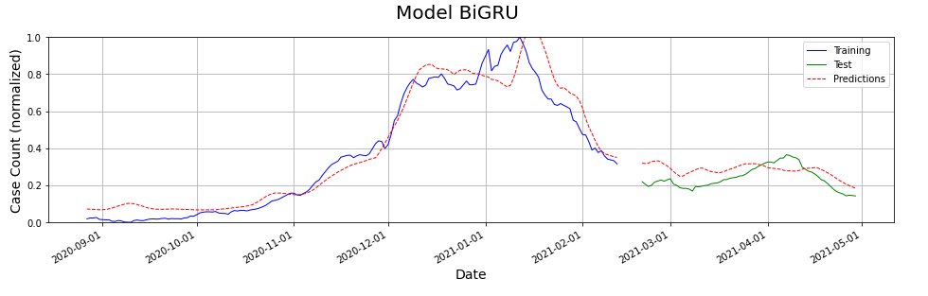
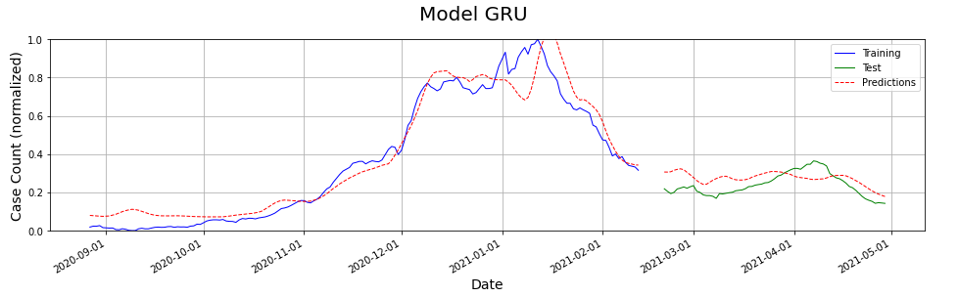
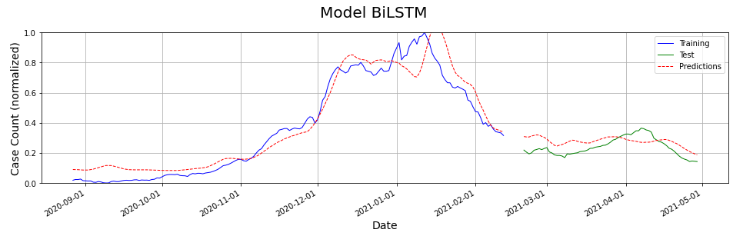
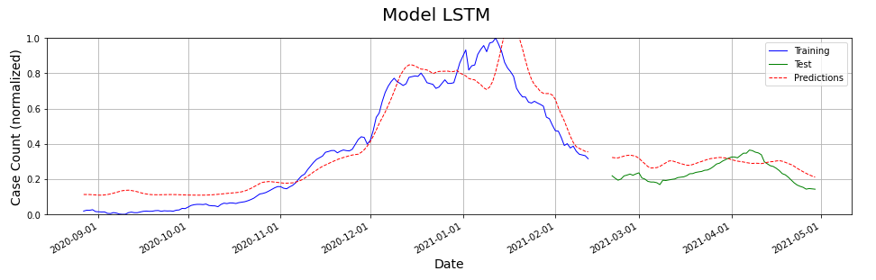
Model Predictions – Gradient Boosting Regression Model
Final Project Group #111 V Bhatia, P Bhatt, L Bondili, R Soori
20
Notes:
We tried a multitude of deep learning models including CNN, GRU, LSTM and bi-directional models and found that they all provided very similar results.
The predicted values follow a similar trend as the training and test data but are lagged by a 5-6 days which in turn reduces the effectiveness of the models.

Slide 21
Takeaways from first attempt
All models fair poorly in comparison to the persistence model using only the wastewater RNA signal as the predictor variable.
Piecewise Linear Models such as GAMS and XGBoost show good results on training data however fair poorly on test (unseen data)
Dataset including predictor and response variables are noisy hence the outputs are somewhat expected since we are fitting noise to noise.
Final Project Group #111 V Bhatia, P Bhatt, L Bondili, R Soori
21

Slide 22
ATTEMPT # 2
USING AUTO REGRESSIVE MODEL + STANDARD PREDICTORS
Final Project Group #111 V Bhatia, P Bhatt, L Bondili, R Soori
22
Notes:
Now coming to data processing,
Our target variable has different interpretations for positive and negative values.
so we used an absolute value where lower number would indicate high mortality risk and higher number would indicate lower risk.
For identifying race, we used the distribution of race in 70s and for sex, we leveraged the fact that males and females have different ranges for some of the clinical variables like RBC.
For filling in the missing data in our dataset, we used an iterative imputer.
We added some new flags indicating predictors outside of normal range. e.g. if a person had high BMI, we would either flag it as 1 or 2 depending on the range and then used a sum_flag that would add up these flags to indicate an overall health of a person.
22

Slide 23
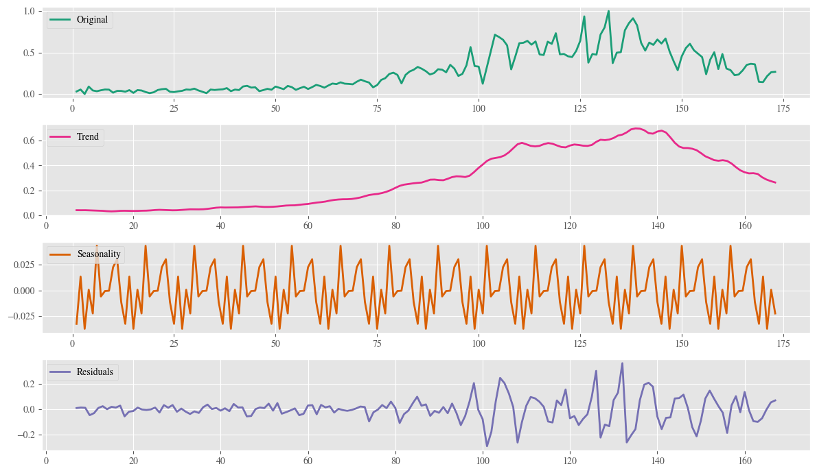
SARIMA MODEL
TAKE AWAY
On decomposing the training data into trend, seasonality and residuals, we see that there is seasonality in the data
This encouraged us to add independent variables such as the Day of the Weekday, Day of the Month as predictors to further our enhance.
Final Project Group #111 V Bhatia, P Bhatt, L Bondili, R Soori
23

Slide 24
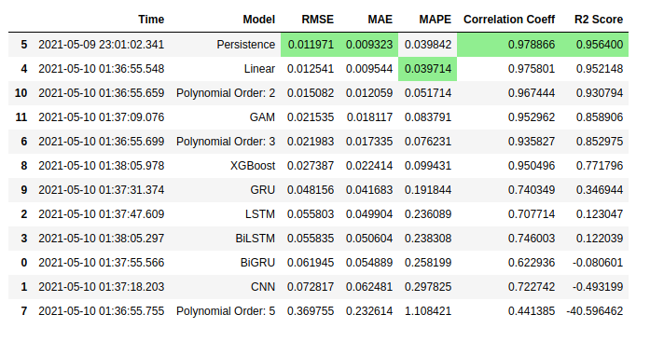
Model Comparison – Auto Regressive + Wastewate Signal
Predictor Variables:
7 Day Rolling Average of Confirmed COVID-19 Case Count from previous day
7 Day Rolling Average of Southern Viral RNA Signal
7 Day Rolling Average of Northern Viral RNA Signal
Seasonality Variables – Day of the Week, Day of the Month
Response Variables:
7 Day Rolling Average of Confirmed COVID-19 Case Count
Figure: Evaluation of performance metrics relative to the baseline (Persistence) Model using Test Data
Final Project Group #111 V Bhatia, P Bhatt, L Bondili, R Soori
24

Slide 25
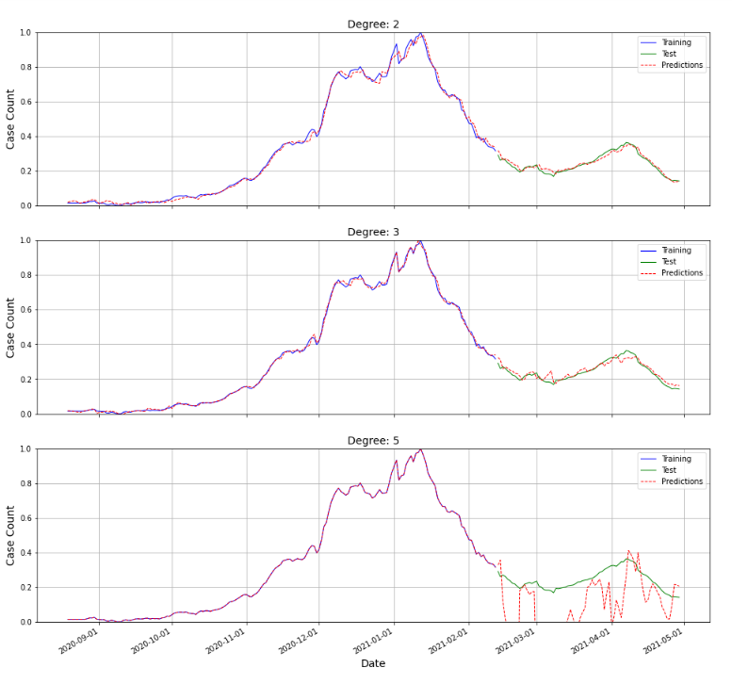
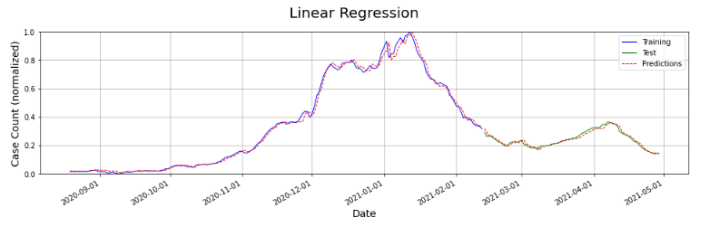
Model Predictions – Baseline Model and Simple Regression
Final Project Group #111 V Bhatia, P Bhatt, L Bondili, R Soori
25

Slide 26
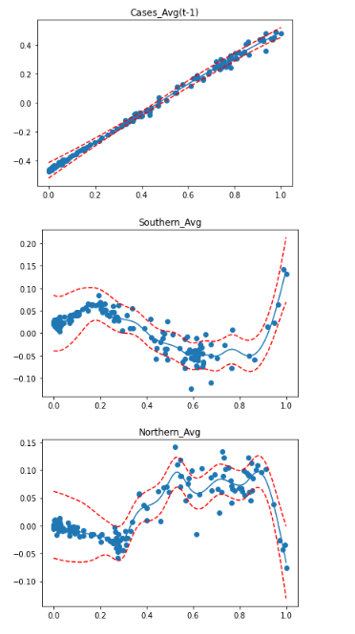
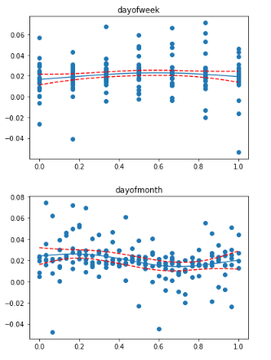
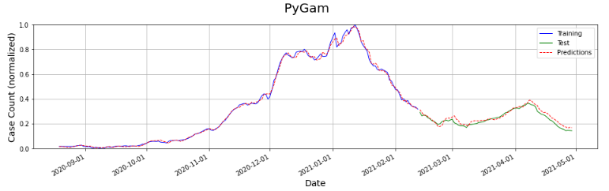
Model Predictions – Generalized Linear Models
Final Project Group #111 V Bhatia, P Bhatt, L Bondili, R Soori
26

Slide 27
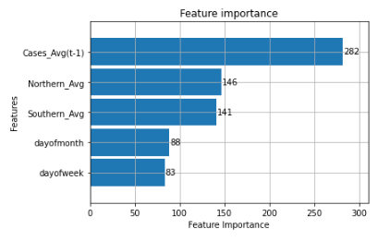
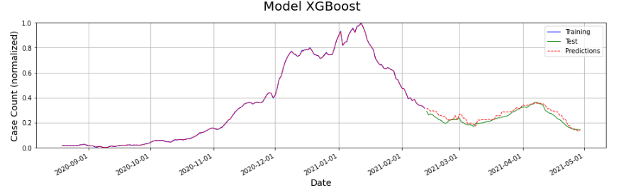
Model Predictions – Gradient Boosting Regression Model
Final Project Group #111 V Bhatia, P Bhatt, L Bondili, R Soori
27

Slide 28
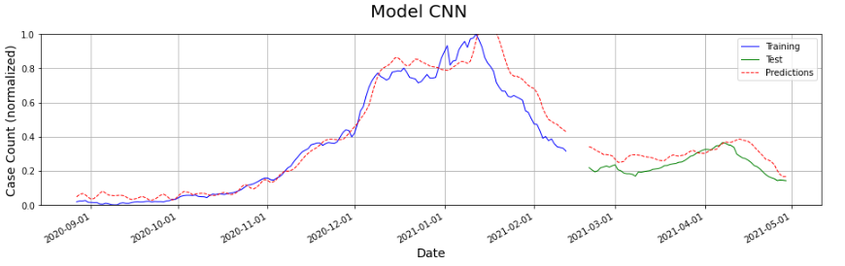
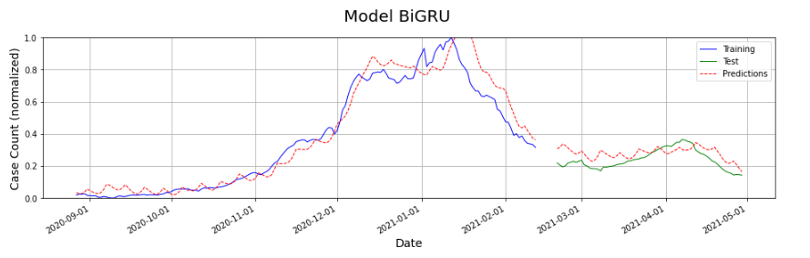
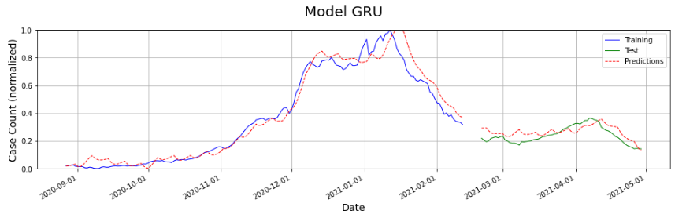
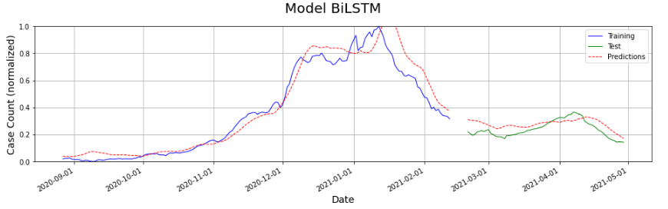
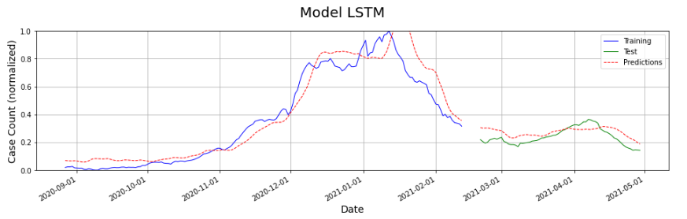
Model Predictions – Gradient Boosting Regression Model
Final Project Group #111 V Bhatia, P Bhatt, L Bondili, R Soori
28

Slide 29
Conclusion
Time series decomposition of the training data shows that there could be an underlying seasonal factor in the data. We accounted for this by splitting the date variable into day-of-month and day-of-week.
Adding the output of the persistence model as an input variable has improved the predictive capabilities of all models. Auto regressive models may still end up being more powerful than using proxy predictor variables for this particular problem.
Final Project Group #111 V Bhatia, P Bhatt, L Bondili, R Soori
29

Slide 30
Next Steps
Covid-19 data collection with respect to waste-water-management is very limited. To improve the predictive capability of the models we developed, we would like to add proxy variables to the models such as social media data analysis and clinical data.
Use deconvolution method to utilize number of deaths and extrapolate the number of cases in each county. This might help reduce noise in the dataset.
Final Project Group #111 V Bhatia, P Bhatt, L Bondili, R Soori
30

Slide 31
Acknowledgments
We acknowledge and thank the contributions of the following people for their help and guidance with this project.
Mentor: Dr. Mauricio Santillana
CS109b Teaching Staff - Pavlos Protopapas, Mark Glickman, Chris Tanner
Teaching Fellows and Teaching Assistants
Fellow Students of CS109b (Spring’ 2021)
THANK YOU
Final Project Group #111 V Bhatia, P Bhatt, L Bondili, R Soori
31

Slide 32
BACKUP SLIDES

Slide 33
Project Proposal
We intend to explore and establish the relationship between wastewater surveillance data collected and maintained by the Massachusetts Water Resources Authority, and the outbreak of COVID-19 in the neighboring communities.
We used supervised learning techniques to develop models which can closely predict the current count of COVID-19 cases in the community using solely the data available from wastewater viral titers
Final Project Group #111 V Bhatia, P Bhatt, L Bondili, R Soori
33

